Slide 1
How to run the Python file

Slide 2
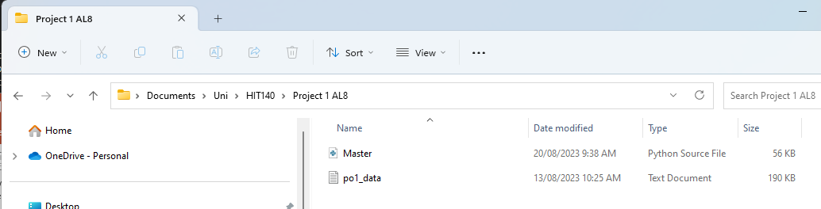
Make sure the 2 files you just
Downloaded are in their own folder
Just like the folder above
We do this because when the python program is looking for
associated files such as po1_data, it will need to be in the folder
it is operating in, or the users personal windows user file. Everyone's
personal windows directory is different, so trying to have a program
that works with everyone's own Windows structure is not practical.

Slide 3
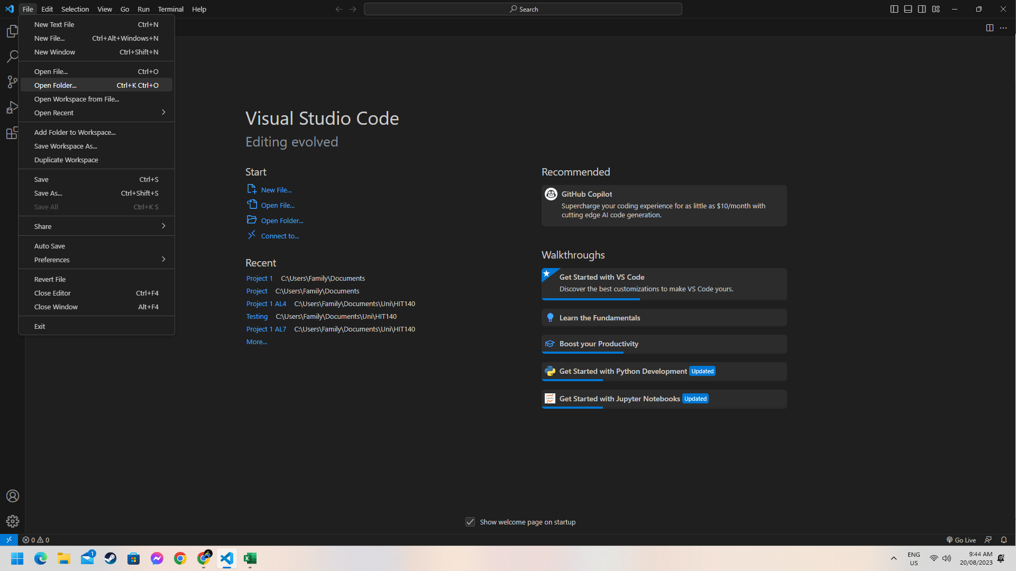
Open Visual Studio Code, then select File in the top left, and Open Folder

Slide 4
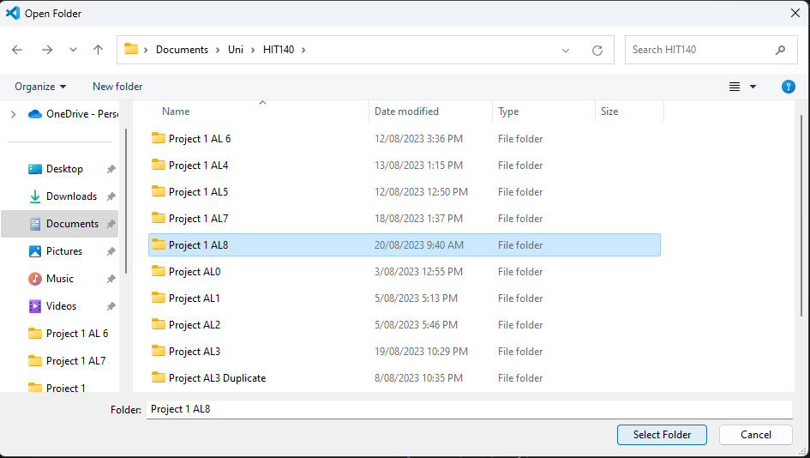
Once Open File has been selected you will be presented with this window
Select the folder you placed the 2 files, in my case I created a folder called Project 1 AL8 (you can call it whatever you want, AL8 is just a versioning title I use). Then click the Select Folder button in the bottom right of the window.

Slide 5
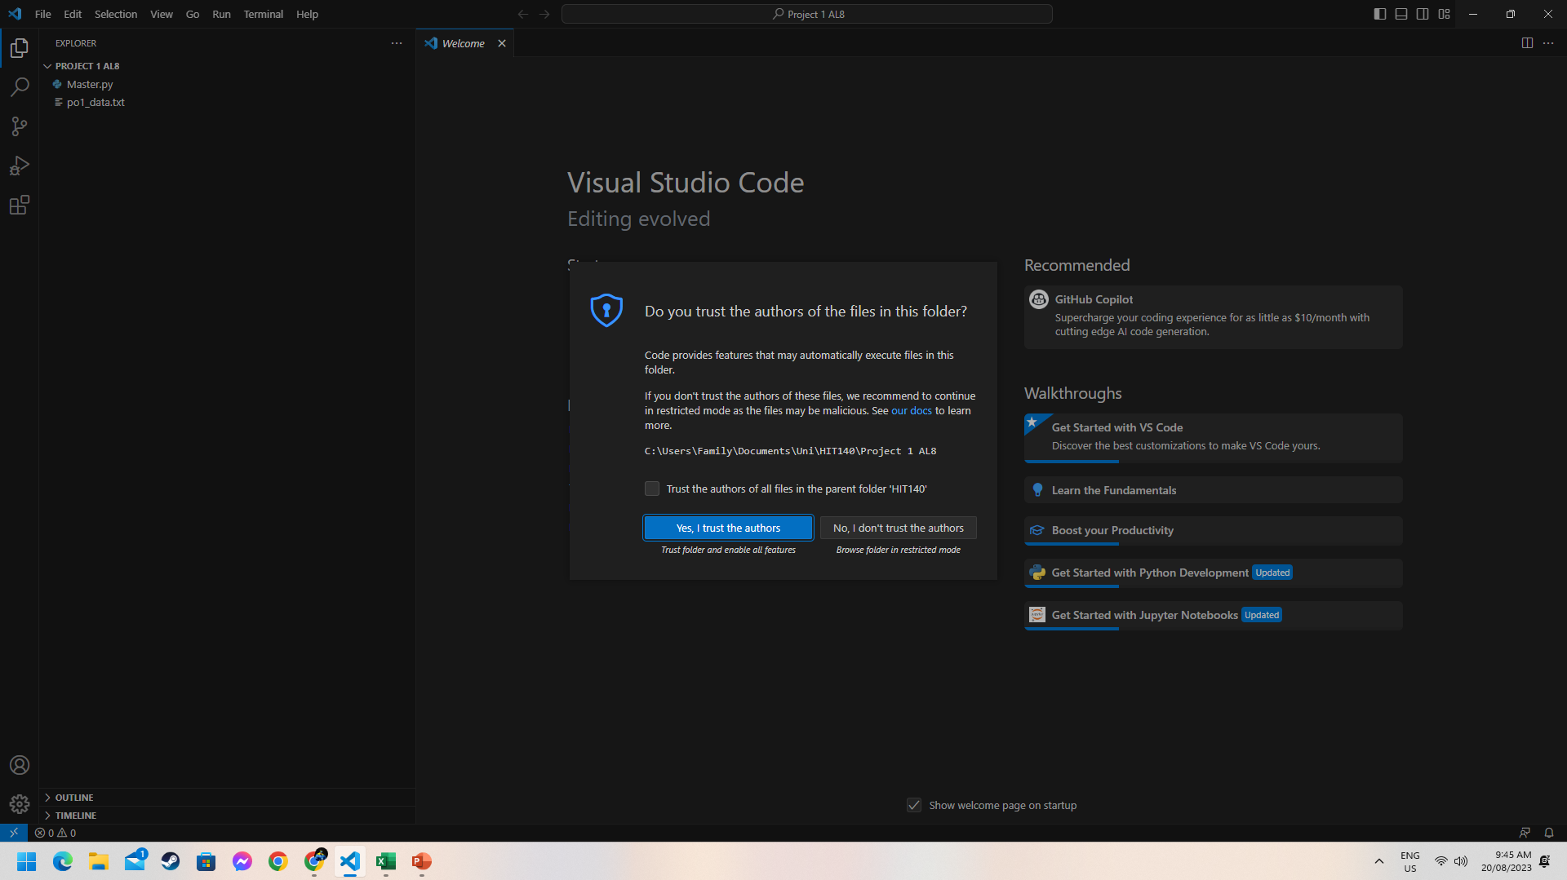
You will receive this prompt, select Yes, I trust the authors to proceed.

Slide 6
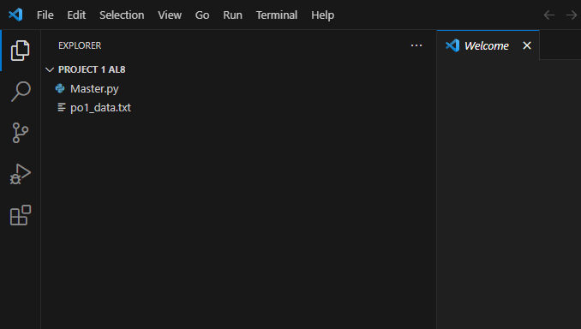
This is what your left hand pane should look like.
The folder title
And the 2 files
The data file po1_data.txt must be called this exactly. If you have downloaded it multiple times it may
appear as po1_data.txt (1) or po1_data.txt (2). For the Python program to find it, it must be titled
po1_data.txt. If it is different just rename it to po1_data.txt.

Slide 7
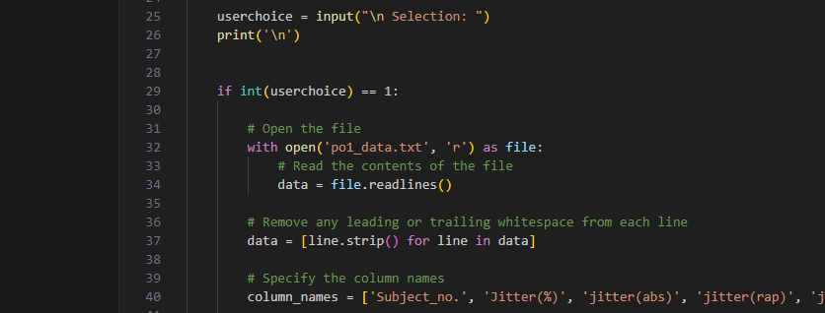
As mentioned a few times already, you can see the program is written so that it is looking for po1_data.txt
Any variations of the file name means that Python will not find it and you will get an error and the program
will terminate.
Also as mentioned in slide 2, the Python will only look in the folder you are working in to find po1_data.txt. If
You have it in another folder, the program wont be able to find it and will terminate with an error message.
*You can write out its location if you don’t want to open it in its own folder, but this will be cumbersome and it
will only work for you, if someone else wants to use the program they will have to go through and modify it to
suit their directory.

Slide 8
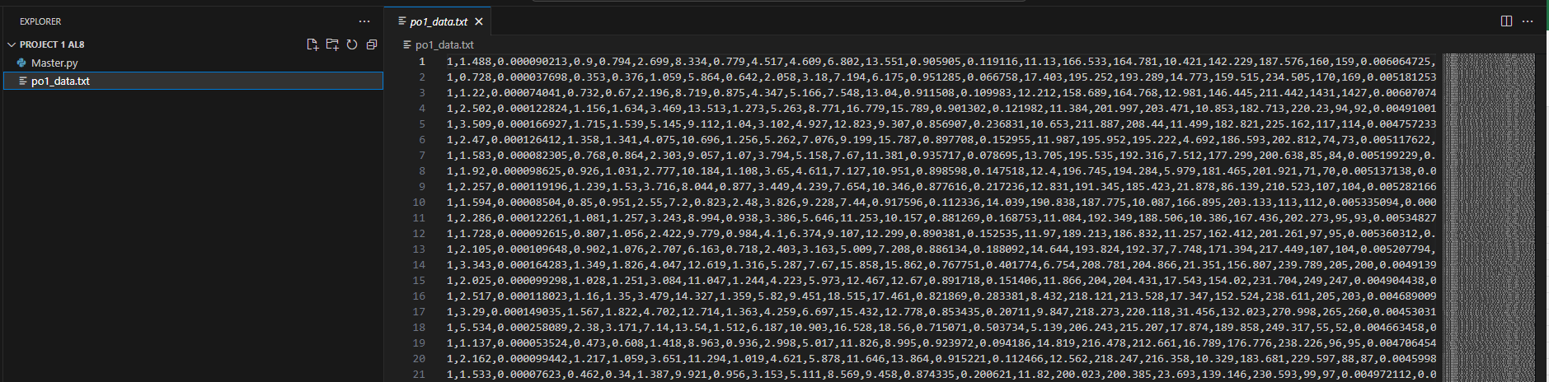
If you select the po1_data.txt file in the left hand pane it will show you the file in plain text. You don’t have to do this, but you can click on it to see that you are working with the correct file.

Slide 9
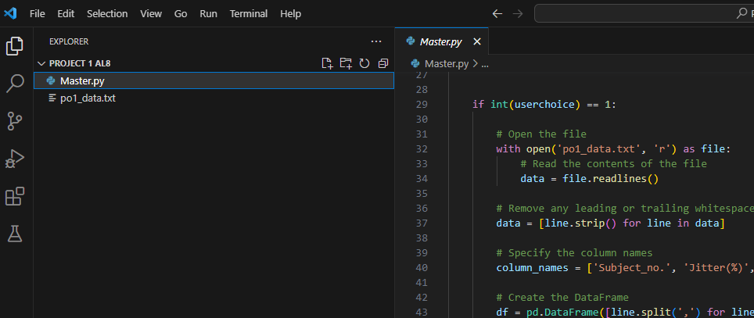
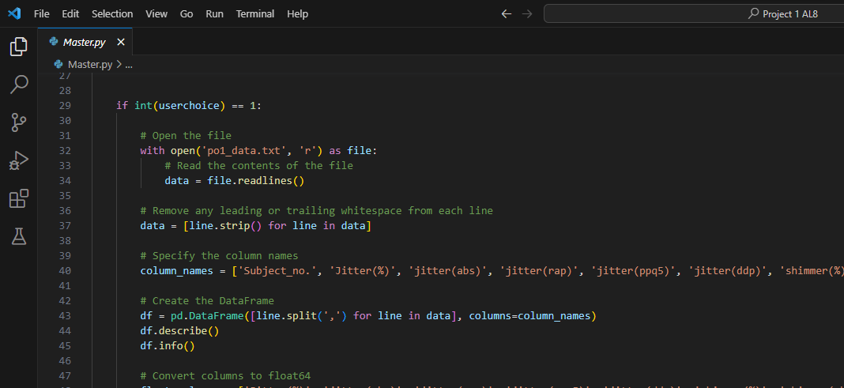
Select the Master.py file in the left pane to make is display in the right pane. Once this is done you can select the explorer icon and it will make the left pane disappear, creating more space for you to review both your program and its operation.

Slide 10
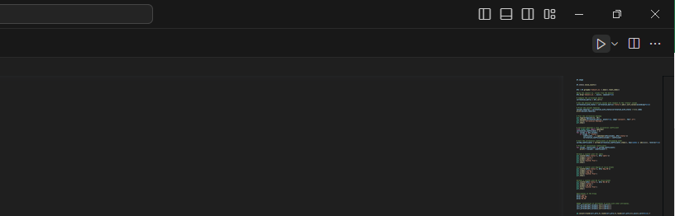
When you are ready to run the program select the play button in the top right side of the screen

Slide 11
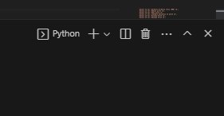
The program will open in the ‘Terminal’ window, to maximise the terminal to make the program more visible press the up button on the right hand side of the terminal window.

Slide 12
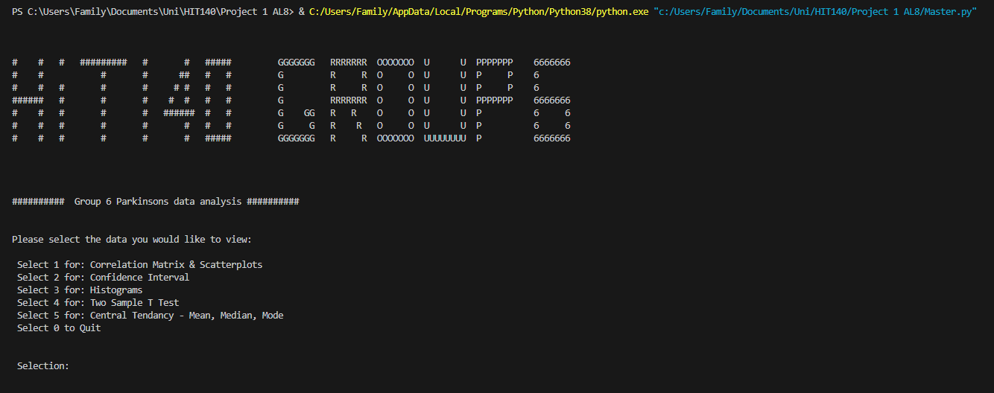
This is what you should see. You will need to click in the window before it allows you to enter a number. Simply
enter the number you want i.e. ‘1’, and it will run that selection for you.

Slide 13
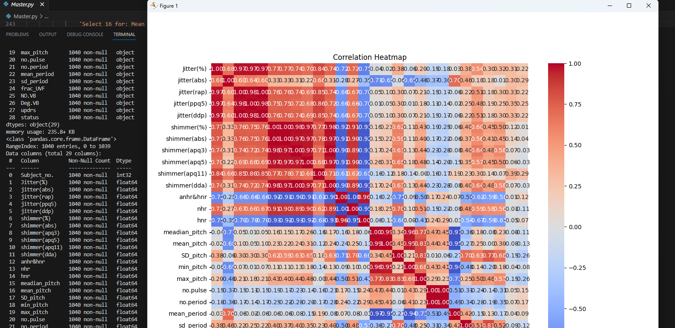
As you can see here after selecting ‘1’ it will run through the program Paulino wrote and display the data
in the terminal window and it will open a new window displaying the Correlation Heatmap.
To progress with the program you will need to select the ‘X’ in the top right corner of the heat map (Window
labeled Figure 1), after doing this the program will execute its next section of code.

Slide 14
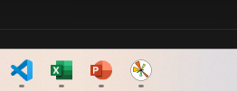
If you accidently click somewhere else on screen that isn’t in the Figure 1 window (the heatmap figure), VS Code will appear on top of the Figure 1 window (it will disappear) and the program will not progress. To get back to the Figure 1 window select the above icon on your task bar.

Slide 15
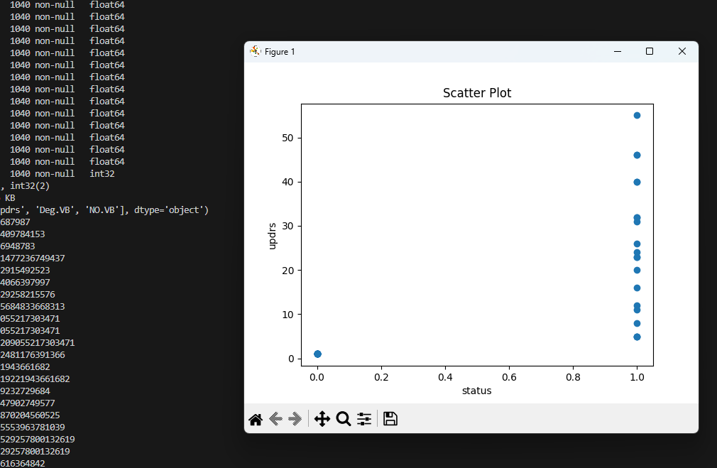
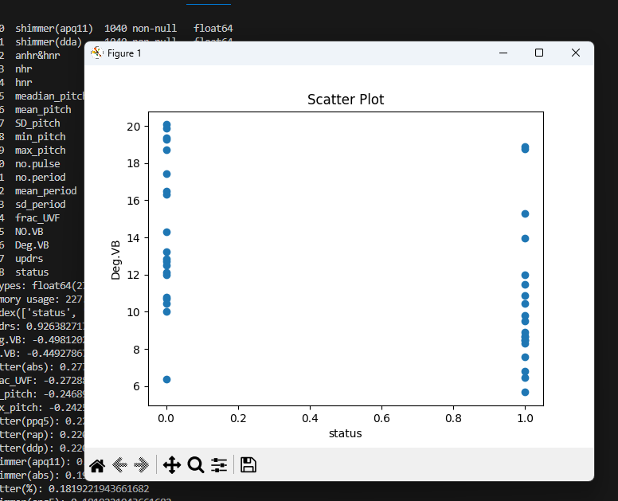
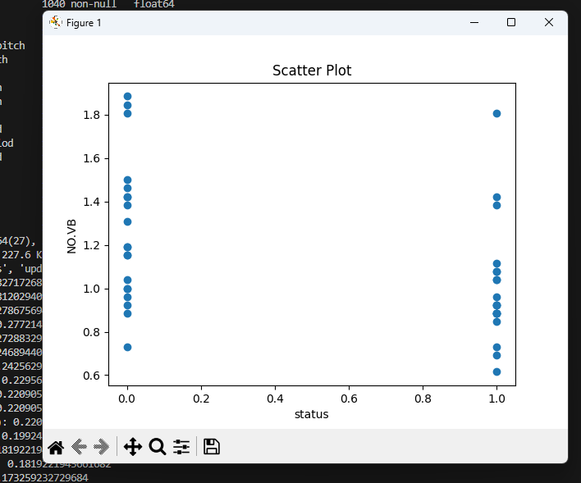
In the case of the Correlation Matrix program, every time you close the Figure 1 window, it will execute the
next line of code. There are 4 windows that will open for this window, the Correlation Matrix and 3 scatter plots.
After reviewing each window for the data close it and it will progress to the next window until the program is complete
It will then take you back to the ‘Main Menu’ so you can run another program or exit the program.

Slide 16
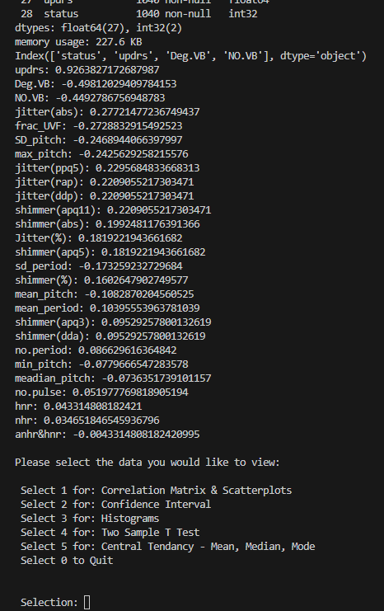
As seen in the last slide, once the program is complete you will be presented
with the ‘Main Menu’ . From here you can enter another program by selecting
its number or entering ‘0’ (zero) to quit.

Slide 17
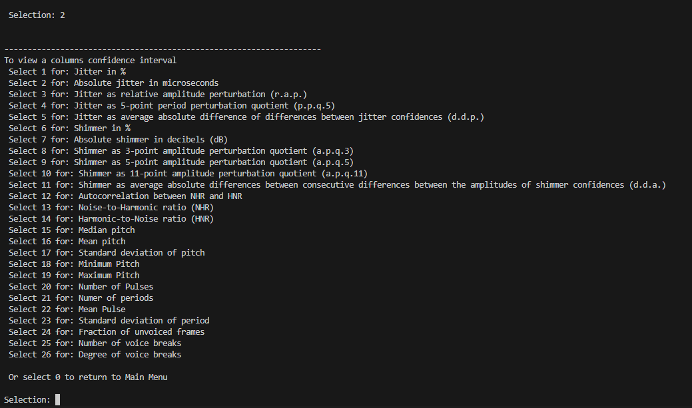
If you enter selection ‘2’, you will be presented with another menu. I've done this so that you are not overwhelmed with data and can review the data in a selected column to confirm your hypothesis is accurate from a different set of data.

Slide 18
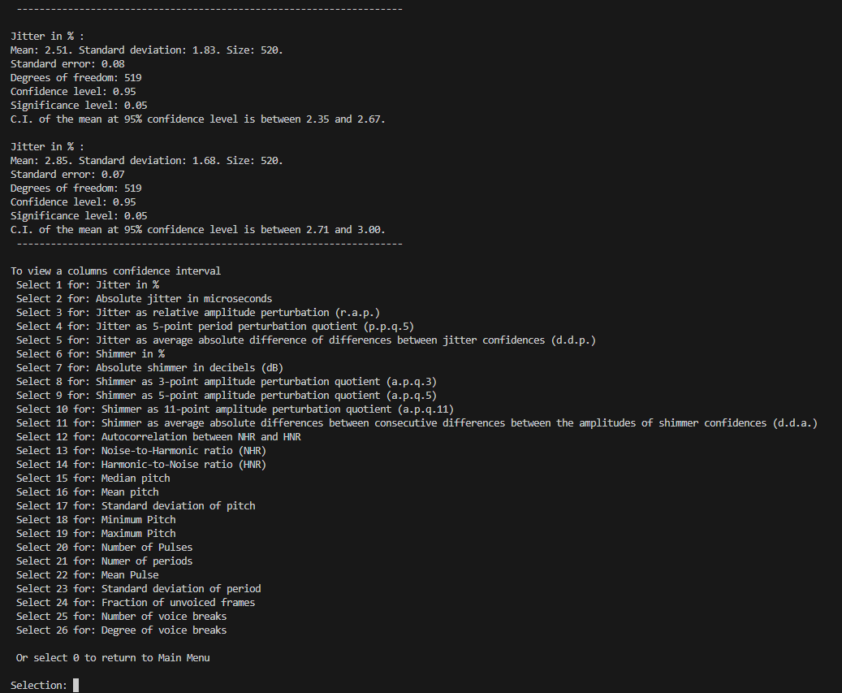
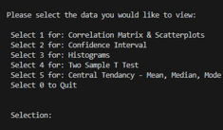
As you can see here, with 1 selected in the sub menu it will display the results for the ‘Jitter in %’ column The top mean, standard error, degrees of freedom, CI etc. relates to the people who have Parkinson, and the second, standard error, degrees of freedom, CI etc. relates to the data for people without Parkinson’s
Selecting ‘0’ from here will return you
to the ‘Main Menu’.

Slide 19
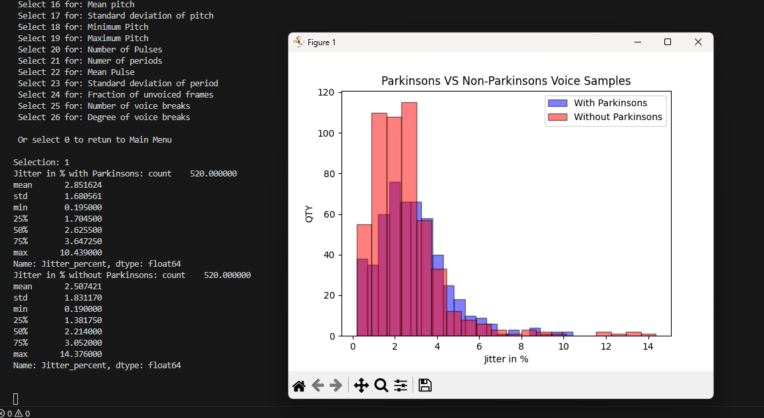
Selecting ‘3’ in the ‘Main Menu’ will allow you to view overlapping histograms. As with the ‘Confidence Interval’ program from the last slide, so it doesn’t flood you with information, the Histogram program allows you to view the column you would like to see. It will then present you with a Histogram with two sets of data on it and allows you to visually compare the data from people with Parkinsons to people without Parkinsons to see if there is a difference between them.

Slide 20
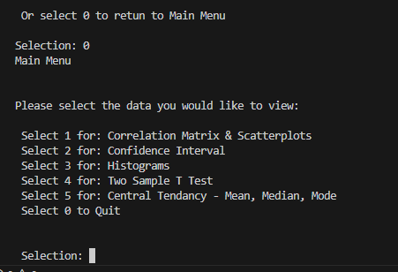
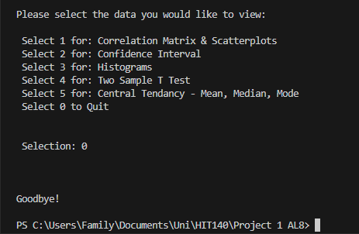
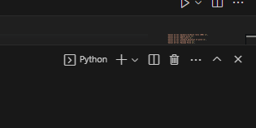
Once you have finished reviewing your data select ‘0’ to return to the ‘Main Menu’, then select ‘0’ again to ‘Quit’. Once the program ends you will get a ‘Goodbye!’ message and you can select the ‘X’ in the right hand side of the terminal window to close the terminal.

Slide 21
END

